Slide 1
AETHERIX
Autonomous Extraterrestrial High-throughput Enhancing Routing
and Inter-planetary eXchange
EduQual Level 6 Diploma in AI Operations | Topic 59
Building an Interplanetary Communication Network with DTN,
Quantum Communication, and Space-Based Infrastructure for Mars Mission Support
Muhammad Abdullah Tariq
September 2026
matx104.github.io/AETHERIX | github.com/matx104/AETHERIX
Notes:
Name clearly. Read the Topic 59 title exactly as on the exam paper. Pause. (30 seconds)

Slide 2
PRESENTATION AGENDA
01 The Challenge
07 Orbital & Doppler
Why space breaks the internet
Contact windows, synodic period
02 DTN & BPv7
08 Radiation Hardening
Store-and-forward with custody
SEU, TMR, ECC, FDIR
03 Topology
09 Data Prioritization
241 nodes, 5 tiers, two worlds
QoS, compression, preemption
04 Link Budget
10 Trade-offs & Failure
1550nm optical analysis
Design choices, conjunction recovery
05 RL Routing
11 Performance & Tools
Multi-agent federated Q-learning
vs current systems, standards
06 Quantum Security
12 Q&A
BB84/E91 + repeater chains
Summary and live demo
AETHERIX — Interplanetary Communication Network
2 / 31
[A2] AETHERIX topology.py (241 nodes) · References slides at end of deck
Notes:
Overview of the ~12 themes you'll cover in ~18 minutes. (20 seconds)

Slide 3
WHAT IS AETHERIX?
Overview & The Problem
What is AETHERIX?
The Problem
Autonomous Extraterrestrial High-throughput Enhancing
Routing and Inter-planetary eXchange
Earth–Mars distance varies from 54.6M to 401M km
— a 7x range swing every 780 days
An architecture for delay-tolerant networking (DTN)
between Earth and Mars
One-way light delay is 3–22 minutes;
round-trip TCP ACK is 6–44 minutes
Replaces static Contact Graph Routing with
reinforcement-learning-based adaptive routing
Solar conjunction causes ~2-week communication
blackouts twice per synodic period
Secures links via Quantum Key Distribution
(BB84 & E91 protocols with repeater chains)
Deep-space links are inherently intermittent:
no continuous end-to-end path exists
Hybrid optical/RF communications across
a 5-tier, 241-node interplanetary topology
Static routing cannot adapt to dynamic
contact schedules and link degradation
Open-source, standards-compliant (CCSDS, IETF)
research platform for deep-space networking
Classical key exchange is infeasible across
interplanetary distances
AETHERIX addresses every one of these challenges — harnessing DTN store-and-forward, AI-driven adaptive routing, quantum-secured key distribution, and hybrid optical/RF links.
AETHERIX — Interplanetary Communication Network
3 / 31
[1] NASA MRN 2024 · [3] JPL Horizons · [12] RFC 4838 · [A2] topology.py
Notes:
Plain-language framing first: AETHERIX is a postal service for interplanetary space. Then the problem: TCP/IP cannot cross Earth-Mars. (1.5 minutes)

Slide 4
THE DISTANCE
Why Space Breaks the Internet
Parameter | Value
Closest approach | 54.6 million km
Farthest distance | 401 million km
Distance variation | 7.3× (735%)
One-way light time | 3 – 22 minutes
Synodic period | 780 days (26 months)
Solar conjunction blackout | ~2 weeks (twice/period)
TCP/IP Assumption | Deep-Space Reality
Low latency (< 200 ms) | 6 – 44 min round trip
Continuous connectivity | Scheduled contact windows only
End-to-end path exists | No simultaneous path possible
Reliable ACKs in seconds | ACKs take minutes to hours
"TCP/IP assumes the network is fast, reliable, and always connected.
Deep space is none of those things."
54.6M km
401M km
780 days
0.5–6 Mbps
Min Distance
Max Distance
Synodic Period
Current DSN Rate
AETHERIX — Interplanetary Communication Network
4 / 31
[3] JPL Horizons (distance/light-time) · [12] RFC 4838 (DTN rationale) · [1] NASA MRO data rate
Notes:
Scale: 54.6M to 401M km; light alone takes 3-22 minutes one way; TCP assumes sub-second round trips. (1.5 minutes)

Slide 5
THE ANSWER
Delay-Tolerant Networking
Bundle
Store
Wait
Forward
Deliver
Create data
bundle (BPv7)
→
Buffer at
local node
→
Hold until
contact window
→
Transmit to
next hop
→
Reach final
destination
BPv7
Bundle Protocol v7
RFC 9171 — store &
forward with custody
AI Routing
Multi-agent federated
Q-learning adapts in
real time to contacts
QKD
BB84 & E91 quantum
key distribution with
repeater chains
Think of it like the postal service: you don't need a continuous connection between sender and receiver — each post office (node) stores the letter (bundle) until the next truck (contact window) is available, then forwards it one hop closer to the destination.
AETHERIX — Interplanetary Communication Network
5 / 31
[9] RFC 9171 BPv7 · [10] RFC 5326 LTP · [11] RFC 7242 TCPCL · [12] RFC 4838
Notes:
DTN store-and-forward: each node takes custody. Bundle to Store to Wait to Forward to Deliver. BPv7, RFC 9171. (1.5 minutes)

Slide 6
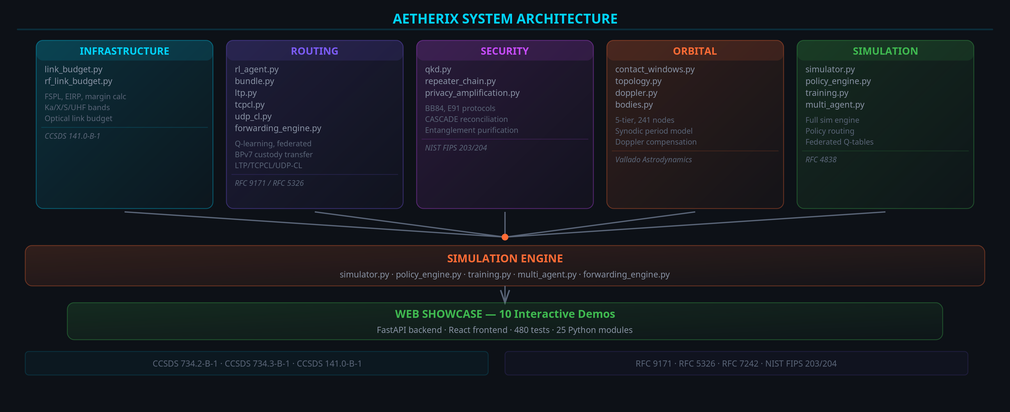
SYSTEM ARCHITECTURE
AETHERIX — Interplanetary Communication Network
6 / 31
[A1] rl_agent.py · [A2] topology.py · [A4] link_budget.py · [A5] qkd.py · github.com/matx104/AETHERIX
Notes:
Architecture diagram: six source modules feed the simulation engine and the web showcase; every module is independently tested. (20 seconds)

Slide 7
BPv7 DEEP DIVE
The Foundation
Application Layer
Priority | Class | Use Case
P0 | EMERGENCY | Life-critical alerts, abort commands
P1 | URGENT | Navigation corrections, hazard warnings
P2 | NORMAL | Telemetry, science data, commands
P3 | LOW | Software updates, bulk file transfer
P4 | BULK | Background sync, archival data
User data, commands, telemetry
▼
Bundle Protocol v7
Routing, custody, fragmentation, TTL
▼
Convergence Layer
LTP (space), TCPCL (Earth), UDPCL (ISL)
▼
Store-and-Forward Steps
Physical Layer
1. Bundle created at source with destination EID + TTL
Optical 1550nm / Ka-band RF links
2. Node stores bundle in priority queue (buffer mgmt)
3. Contact window opens → best next-hop selected by RL
4. Bundle transmitted via convergence layer (LTP/TCPCL)
5. Custody transfer confirms; repeat until destination
Standards: RFC 9171 (BPv7) • RFC 4838 (DTN Arch) • RFC 5326 (LTP) • CCSDS 734.2-B-1 • CCSDS 734.3-B-1 (SABR)
AETHERIX — Interplanetary Communication Network
7 / 31
[9] RFC 9171 · [2] CCSDS 734.2-B-1 · [10] RFC 5326 LTP · [11] RFC 7242 TCPCL · [12] RFC 4838
Notes:
The stack: Application, BPv7 (custody/fragmentation/TTL), convergence layers (LTP/TCPCL/UDPCL), physical. P0-P4 priorities. (2 minutes)

Slide 8
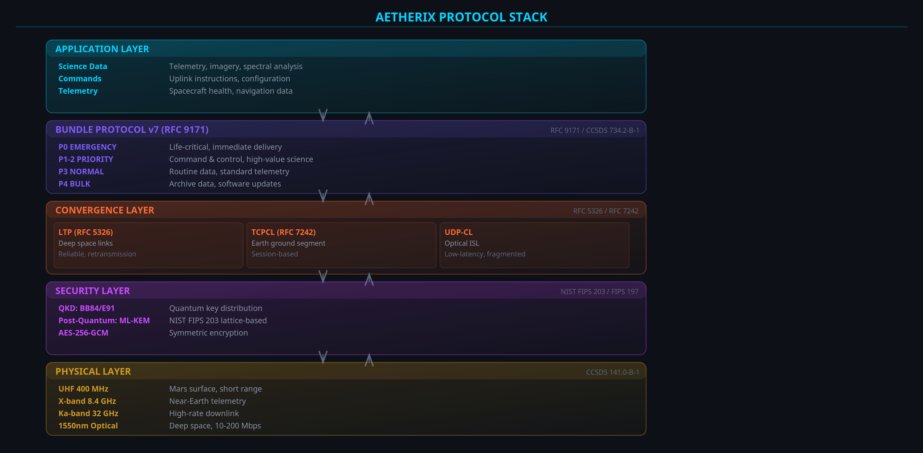
PROTOCOL STACK
AETHERIX — Interplanetary Communication Network
8 / 31
[9] RFC 9171 · [10] RFC 5326 · [11] RFC 7242 · [2] CCSDS 734.2-B-1
Notes:
The layered protocol stack: BPv7 over LTP / TCPCL / UDP-CL over optical 1550nm and Ka-band RF. (15 seconds)

Slide 9
NETWORK TOPOLOGY
241 Nodes, 5 Tiers
T1 Earth Ground
5 nodes — 3 DSN (Goldstone, Madrid, Canberra) + MOC + SOC
T2 Earth Orbital
51 nodes — 3 GEO relays + 48 LEO laser constellation
T3 Deep Space Transit
4 nodes — ES-L4, ES-L5 + 2 transfer-orbit relays
T4 Mars Orbital
4 nodes — 2 areostationary + 1 polar + 1 orbiter
T5 Mars Surface
177 nodes — 2 bases, 5 rovers, 10 drones, 160 sensors
Multiple redundant paths · No single point of failure · Lagrange relays for conjunction coverage
AETHERIX — Interplanetary Communication Network
9 / 31
[A2] AETHERIX topology.py (241 nodes, 5 tiers) · [1] NASA Deep Space Network (Goldstone/Madrid/Canberra)
Notes:
241 nodes across 5 tiers: 5 / 51 / 4 / 4 / 177 (matches topology.py). Walk each tier: DSN, LEO mesh, Lagrange relays, areostationary, Mars surface. (2 minutes)

Slide 10
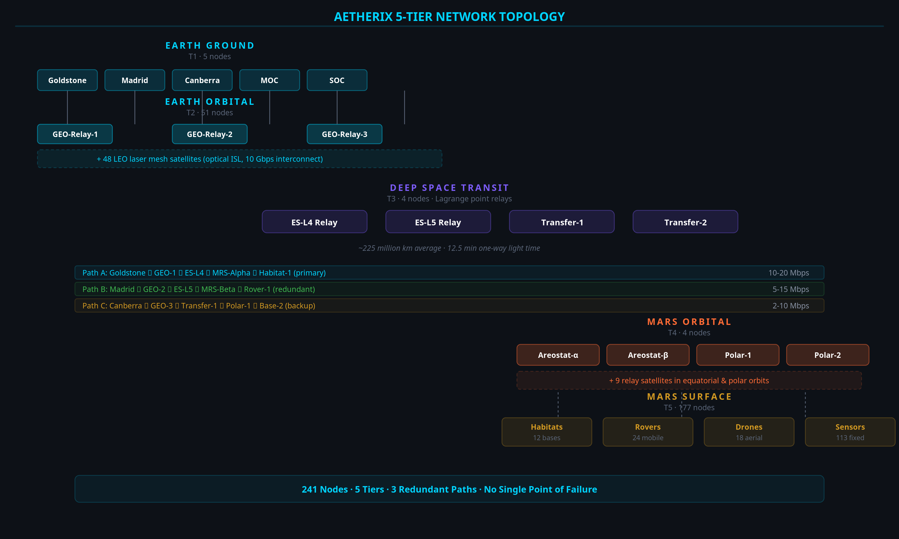
5-TIER NETWORK DIAGRAM
AETHERIX — Interplanetary Communication Network
10 / 31
[A2] topology.py (241 nodes, 5 tiers) · [3] JPL Horizons (ES-L4/L5) · [1] NASA DSN
Notes:
Visual of the 5-tier topology: 241 nodes, 3 redundant paths, Lagrange relays for solar-conjunction coverage. (20 seconds)

Slide 11
OPTICAL COMMUNICATIONS
10–100x Capability Over RF
100–200
Mbps at closest approach
10–20
Mbps average distance
2–5
Mbps at farthest point
Key Equations
FSPL = 20·log₁₀(4πd/λ) — free-space path loss
Gain = 10·log₁₀(η·(πD/λ)²) — antenna gain
Pr = Pt + Gt + Gr − FSPL — received power
Parameter | Value
Wavelength | 1550 nm
Tx Power | 5 W
Tx Aperture | 22 cm
Rx Aperture | 1.0 m
AETHERIX — Interplanetary Communication Network
11 / 31
[5] CCSDS 141.0-B-1 (optical link) · [A4] AETHERIX link_budget.py · [1] NASA MRO (6 Mbps RF baseline)
Notes:
1550nm optical link budget; three distance scenarios; FSPL grows with distance squared; 1550nm chosen for telecom heritage. (2 minutes)

Slide 12
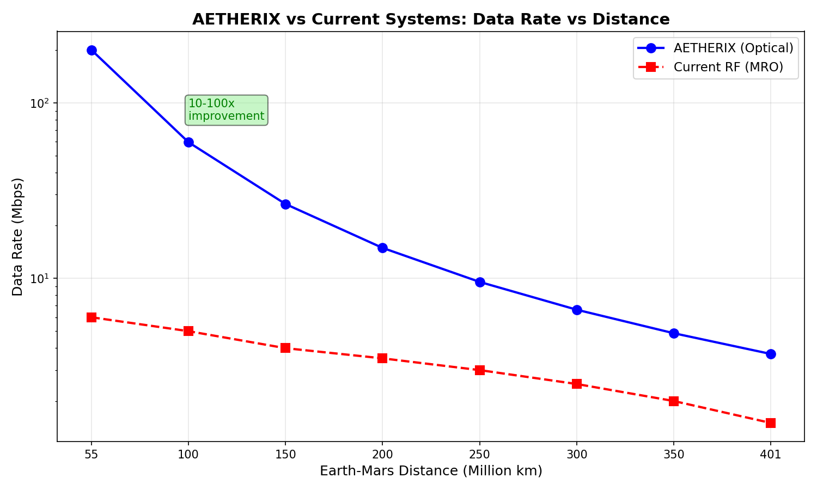
DATA RATE VS DISTANCE
1550 nm Optical Link Performance
200 Mbps at closest approach to 2 Mbps at maximum distance · 10–100× capability over RF [1]
AETHERIX — Interplanetary Communication Network
12 / 31
[5] CCSDS 141.0-B-1 · [A4] AETHERIX link_budget.py (physics-derived capability)
Notes:
End-to-end 500 MB journey, Mars surface to JPL: 7 hops, about 13 min transit vs 12.5 min light-time; stored at each custodian. (20 seconds)

Slide 13
EARTH–MARS DATA JOURNEY
7 Hops from Perseverance Rover to Mission Control
Hop | From | To | Link | Time
1 | Perseverance | MRS-Alpha | UHF | ~5 s
2 | MRS-Alpha | MRS-Polar | Optical ISL | ~1 s
3 | MRS-Polar | ES-L5 | 1550 nm laser | ~12.5 min
4 | ES-L5 | ES-L4 | Optical ISL | ~2 s
5 | ES-L4 | LEO Constellation | 1550 nm laser | ~0.1 s
6 | LEO Constellation | DSN Madrid | Fiber downlink | ~1 s
7 | DSN Madrid | JPL MOC | Terrestrial fiber | ~0.5 s
~13 min
Total Transfer [3]
98.7%
Delivery (target)
15 Mbps
Throughput (target)
7 hops
Path Length [A2]
Stored-and-forwarded at each custodian · ~13 min transit vs 12.5 min one-way light time
AETHERIX — Interplanetary Communication Network
13 / 31
[A2] topology.py (7-hop path) · [3] JPL Horizons (light-time) · delivery/throughput are design targets
Notes:
CGR (NASA today) is static; the RL agent learns. Reward R = a*delivery - b*delay - g*hops - d*drops - e*energy; a=1.0, d=10.0; epsilon-decay 0.995. (2 minutes)

Slide 14
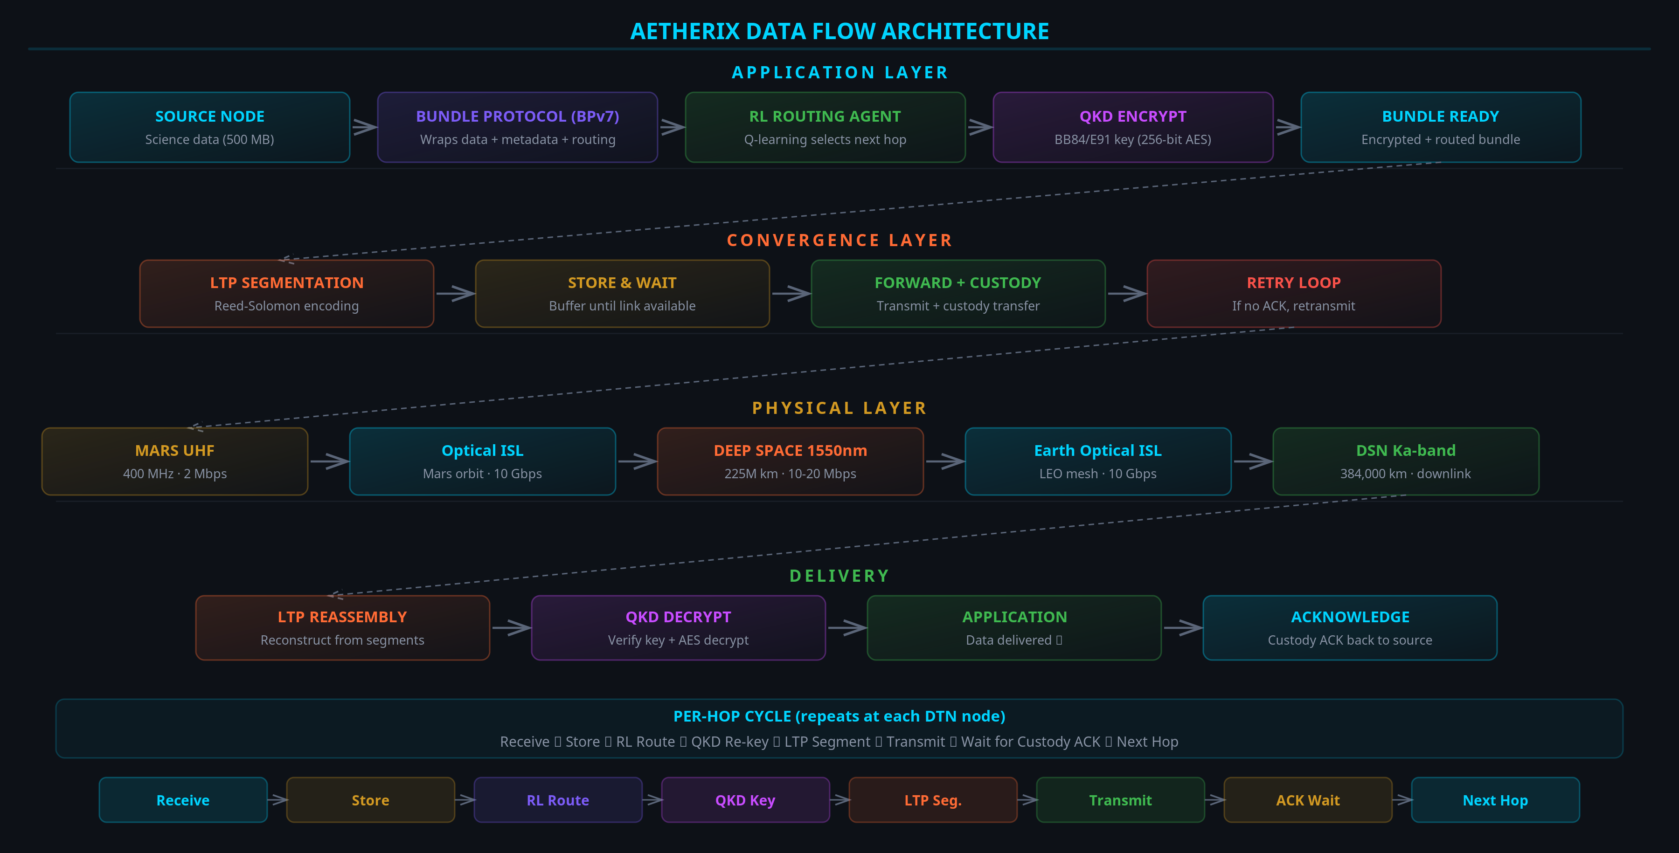
DATA FLOW — MARS TO EARTH
AETHERIX — Interplanetary Communication Network
14 / 31
[A2] topology.py (full data path) · [3] JPL Horizons (light-time) · delivery ratio is a design target
Notes:
The 241-node graph the RL agent routes over: BFS baseline paths refined by Q-learning. (15 seconds)

Slide 15
RL-BASED ROUTING
AI Innovation
Contact Graph Routing
Pre-computed contact plans required
Cannot adapt to unexpected link failures
Computational cost grows O(n³) per route
No learning from historical performance
Single-path — ignores multipath opportunity
RL Agent
State: (node, neighbors, link quality, buffer)
Actions: forward | store | drop | split
Reward: R = α(delivery) − β(delay) − γ(hops) − δ(drops) − ε(energy) [A1]
ε-greedy exploration, decay 0.995 (α=1.0, δ=10.0) [A1]
Q-table + federated aggregation across nodes
713/800
Forward decisions [A3]
seconds
Recovery vs hours [A1]
Q-table
Auditable policy [A1]
AETHERIX — Interplanetary Communication Network
15 / 31
[A1] rl_agent.py (reward fn, ε-decay 0.995) · [A3] run_simulation Module 3 (training convergence 713/800)
Notes:
BB84: send qubits, measure, compare bases, check QBER. Below 11% means no eavesdropper. Plus post-quantum crypto (ML-KEM/ML-DSA) and E91 + repeaters for Mars. (2 minutes)

Slide 16
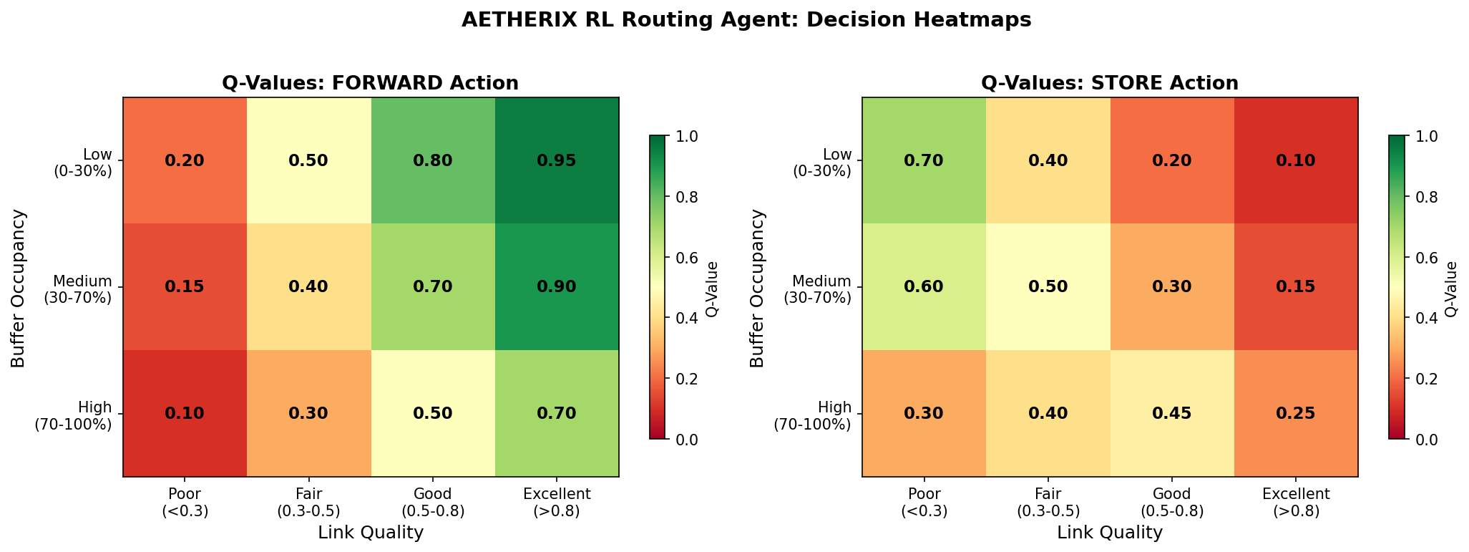
RL ROUTING Q-VALUE HEATMAP
Convergence of Optimal Routing Decisions
Warm colors = high-value actions · Cool colors = poor choices the agent avoids [A1]
AETHERIX — Interplanetary Communication Network
16 / 31
[A1] rl_agent.py · [A3] run_simulation Module 3 (training)
Notes:
26-month synodic period; contact windows vary distance/delay/bandwidth. Doppler compensated: about +/-2.1 MHz at Ka-band at 24 km/s (doppler.py). (1.5 minutes)

Slide 17
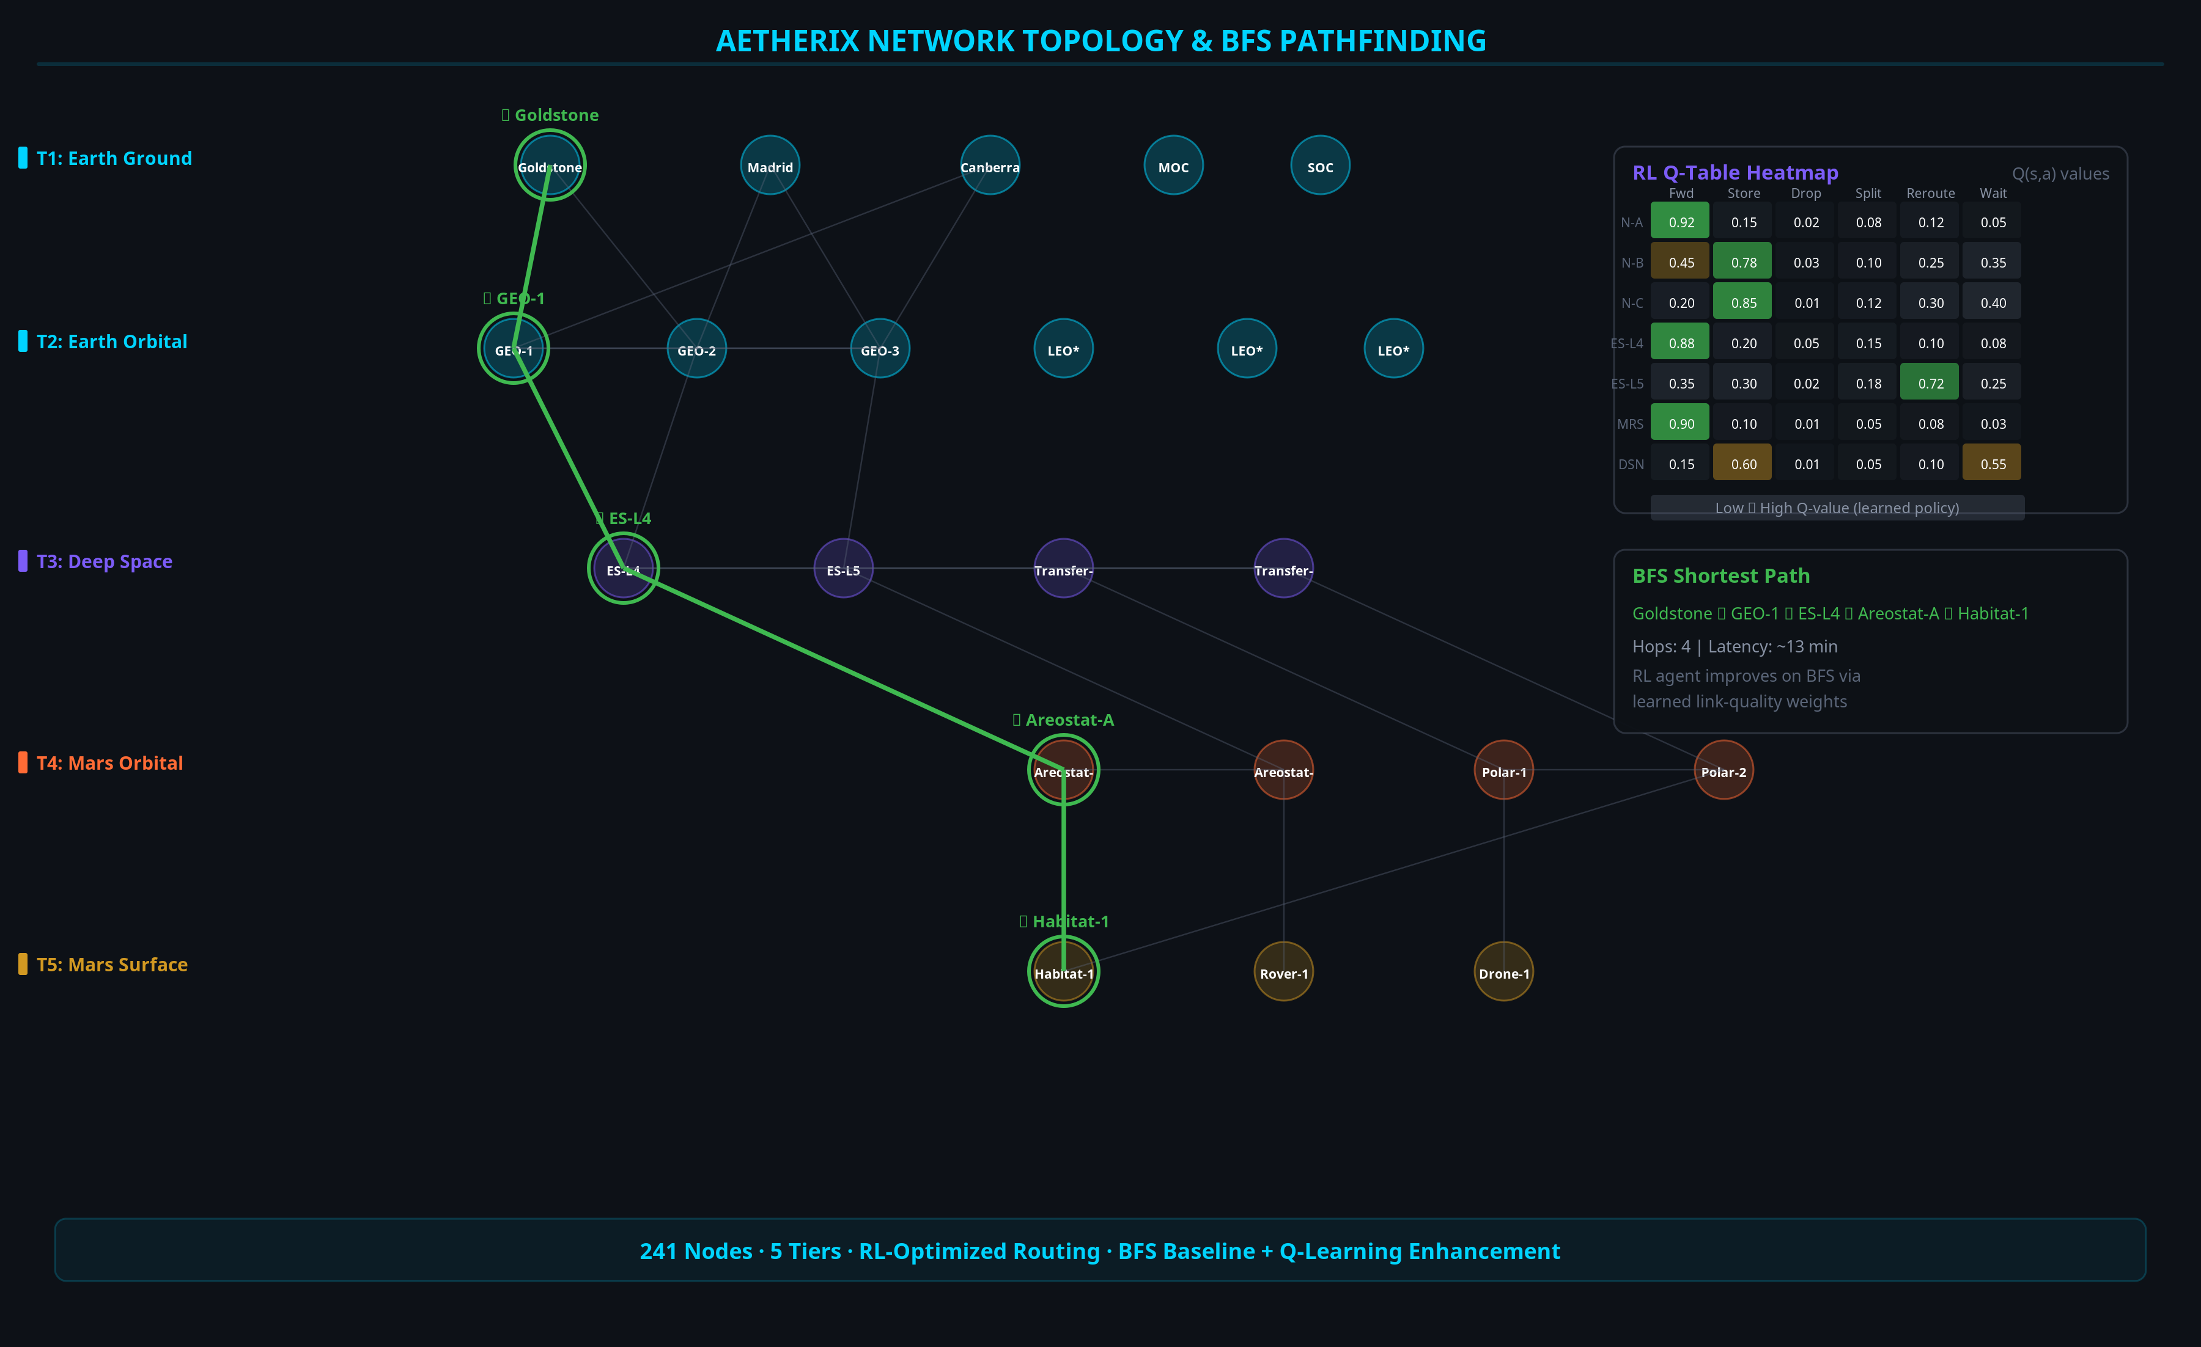
NETWORK TOPOLOGY GRAPH
AETHERIX — Interplanetary Communication Network
17 / 31
[A2] topology.py (241-node graph, BFS) · [A1] rl_agent.py (RL routing on the graph)
Notes:
SEU/MBU/SEL/TID and mitigations (TMR, SECDED, scrubbing, FDIR). Module 6: 37,159 raw upsets to about 186 residual, 200x. RAD750 flight heritage. (1.5 minutes)

Slide 18
QUANTUM SECURITY
Future-Proof
BB84 Protocol
1. Alice sends random polarized photons (H/V, D/A bases) [13]
2. Bob measures each photon in a random basis
3. Public reconciliation — keep matching-basis bits
4. Error estimation — sample subset for QBER
5. Privacy amplification — universal hashing
6. QBER < 11% → SECURE key established [15]
Post-Quantum Cryptography
Kyber (ML-KEM, FIPS 203) — key encapsulation [16]
Dilithium (ML-DSA, FIPS 204) — digital signatures [17]
NIST PQC standard — quantum-resistant
Hybrid classical-quantum key exchange
Phase | Protocol | Key Rate
Phase 1 — LEO | BB84 | 1–10 kbps
Phase 2 — GEO | BB84 + E91 | 10–100 kbps
Phase 3 — Mars | E91 + Repeaters | 1+ kbps
AETHERIX — Interplanetary Communication Network
18 / 31
[13] Bennett-Brassard 1984 · [14] Ekert 1991 · [15] Shor-Preskill 2000 (QBER<11%) · [16][17] NIST FIPS 203/204 · [A5] qkd.py
Notes:
P0-P4 QoS tiers; CCSDS compression (Rice ~3x, wavelet ~10x); deadline-aware preemption; BPv7 fragmentation keeps the link busy. (1.5 minutes)

Slide 19
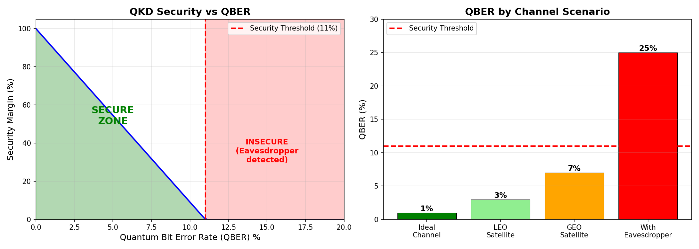
QKD SECURITY ANALYSIS
QBER vs Eavesdropper Detection
QBER < 11% threshold ensures security [15] · Any eavesdropping attempt is detected [13]
AETHERIX — Interplanetary Communication Network
19 / 31
[15] Shor-Preskill 2000 (11% threshold) · [13] BB84 · [A5] AETHERIX qkd.py
Notes:
Be honest about labels. Demonstrated: 241-node topology, RL routing, QKD, 200x radiation reduction. Targets: 10-100x data-rate capability, >95% availability. Compare vs MRO. (1.5 minutes)

Slide 20
ORBITAL MECHANICS
Contact Windows & Doppler Compensation
Parameter | Value
Semi-major axis | 1.524 AU
Synodic period | 779.94 days
Distance range | 54.6M – 401M km
Areostationary altitude | 17,032 km
One-way light time | 3 – 22 minutes
Doppler shift (Ka, max) | ±2.1 MHz @ 24 km/s
Window | Availability | Duration | Data Rate
Optimal | 99% | 8–12 hrs | 100–200 Mbps
Good | 95% | 6–8 hrs | 20–100 Mbps
Fair | 85% | 4–6 hrs | 5–20 Mbps
Blackout | 0% | 2–4 weeks | —
AETHERIX — Interplanetary Communication Network
20 / 31
[3] JPL Horizons (synodic 779.94 d, 54.6M–401M km) · [A2] topology.py · [A4] link_budget.py (windows) · src/orbital/doppler.py (±2.1 MHz Ka Doppler @ 24 km/s)
Notes:
Real, working code: 33 Python modules, 643 tests, 15 demos. Physics is real, no mocked data. 7 CCSDS books + 4 IETF RFCs. (1.5 minutes)

Slide 21
RADIATION-HARDENED COMPUTING
Surviving the Space Radiation Environment (LO-e)
Effect | What it does | Mitigation
SEU (Single Event Upset) | Bit flip in memory/register | SECDED ECC
MBU (Multiple Bit Upset) | ≥2 adjacent bits flipped | Bit interleaving
SEL (Single Event Latchup) | Parasitic short — destructive | Current limit + power-cycle
TID (Total Ionizing Dose) | Cumulative degradation (krad) | Rad-hard parts (RAD750) [18]
Defense-in-Depth Stack
1. TMR — 3 replicas + majority voter masks single fault
2. SECDED (39,32) ECC — corrects 1, detects 2
3. Memory scrubbing — rewrite before 2nd upset
4. FDIR + watchdog — detect → isolate → reload
5. SAFE-MODE after recovery budget exhausted
DEMONSTRATED — run_simulation Module 6 [A6]
37,159
Raw upsets
200×
Protection factor
3,334×
TMR gain (p=1e-4)
2,127×
RAD750 TID margin
Heritage: NASA RAD750 (Curiosity, Perseverance) [18] · ESA LEON3FT [19] · Code: src/computing/radiation.py [A6] · ~186 residual errors vs 37,159 raw (200×)
AETHERIX — Interplanetary Communication Network
21 / 31
[A6] AETHERIX radiation.py (demonstrated Module 6) · [18] BAE RAD750 · [19] ESA LEON3FT
Notes:
Why each choice: hybrid optical/RF, custom RL vs CGR, Q-table now / DQN later. Every choice trades peak performance for auditability and reproducibility. (1.5 minutes)

Slide 22
MISSION-CRITICAL DATA PRIORITIZATION
Bandwidth Triage on a Starved, Intermittent Link (LO-f)
Tier | Class | Examples | BPv7
P0 | Emergency / Safety | Health, collision avoid, faults | EMERGENCY
P1 | Mission-critical | Command ACKs, time-sensitive sci | HIGH_SCIENCE
P2 | High-priority | Routine telemetry, scheduled sci | STANDARD
P4 | Low / Bulk | Housekeeping, file xfer, SW images | BULK
Three Levers
1. Compression (pre-transmit) [7][8]:
Telemetry → CCSDS 121.0-B-3 (Rice) ≈ 3× [7]
Imagery → CCSDS 122.0-B-2 (wavelet) ≈ 10× [8]
2. Deadline-aware preemptive QoS [A7]:
strict priority → earliest deadline; defer if infeasible
3. BPv7 fragmentation [9]:
send what fits; defer rest; link never idle
DEMONSTRATED SCENARIO — src/routing/prioritization.py [A7]
5/6
Items delivered
100%
Link utilisation (target)
41%
SW update fragmented
P0
Emergency preempts
AETHERIX — Interplanetary Communication Network
22 / 31
[A7] AETHERIX prioritization.py · [7] CCSDS 121.0-B-3 · [8] CCSDS 122.0-B-2 · [9] RFC 9171 (fragmentation)
Notes:
Solar conjunction: optical collapses, the agent re-routes to Ka-band via ES-L4/L5 Lagrange relays; P0 forwarded, P4 deferred. run_simulation Module 4. (1.5 minutes)

Slide 23
PERFORMANCE COMPARISON
AETHERIX vs Current
Metric | Current (MRO) [1] | AETHERIX [A4] | Note
Downlink Rate | 0.5-6 Mbps | 2-200 Mbps | 10-100× capability
Daily Volume | 5-10 GB | 50-100 GB | Est. (link-driven)
Availability | 60-75% | >95% | Design target
Routing | Static (CGR) | RL-adaptive | Adaptive [A1]
Security | AES-256 | QKD + PQC | Future-proof [16][17]
Scalability | 5-10 assets | 241 nodes | 10-100× [A2]
Conjunction | Blackout | L4/L5 relay (target) | +50-70% (target) [A8]
AETHERIX — Interplanetary Communication Network
23 / 31
[1] NASA MRO (0.5–6 Mbps) · [A4] link_budget.py (2–200 Mbps capability) · [A2] topology.py · [A8] Module 4 · targets clearly labelled
Notes:
Restate the problem and solution. Point to the numbers, clearly labelled targets vs demonstrated. Offer live demos. (1 minute)

Slide 24
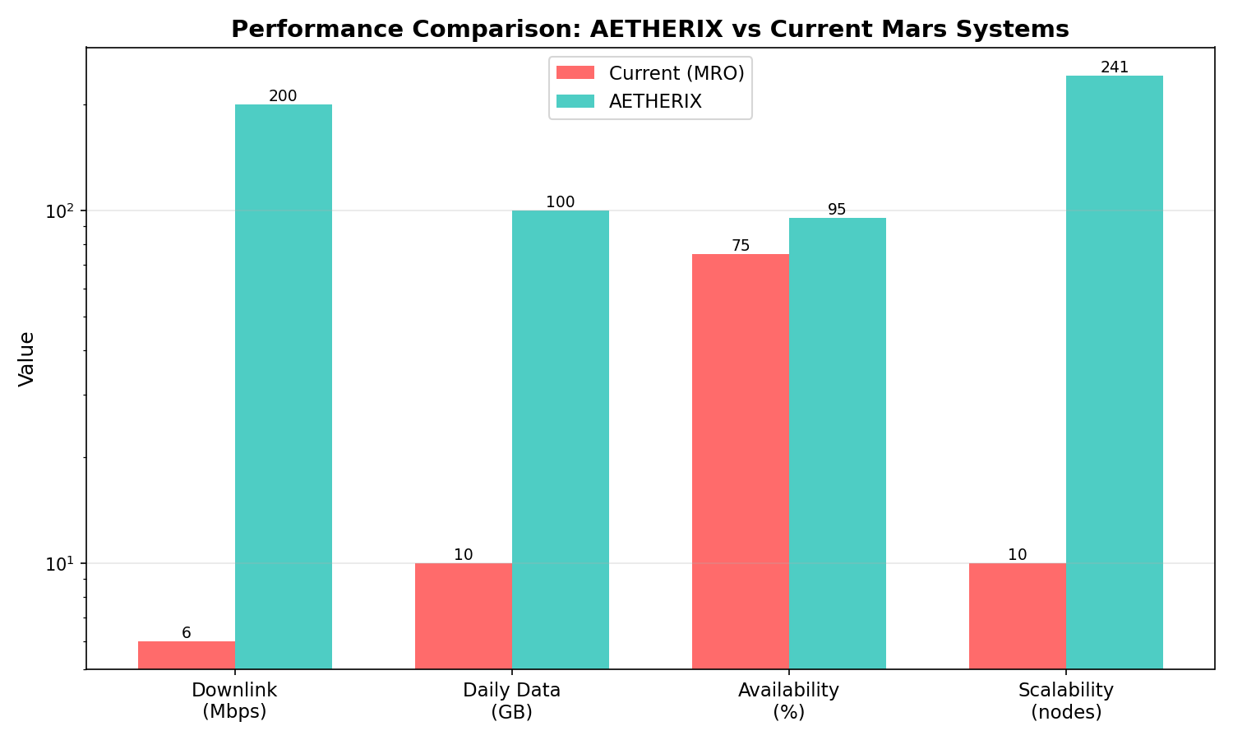
AETHERIX vs CURRENT SYSTEMS
Head-to-Head Performance Metrics
10–100× data-rate capability (link budget [A4] vs [1]) · availability/routing are design targets
AETHERIX — Interplanetary Communication Network
24 / 31
[1] NASA MRO · [A4] AETHERIX link_budget.py · [A2] topology.py
Notes:
Industry and scientific sources [1]-[20]. Keep one keypress away during Q&A; skip in a timed run.

Slide 25
IMPLEMENTATION
What We Built
25
Modules
643
Tests
12
Demos
5
Policies
Core Modules
• Link Budget
• RL Agent
• QKD
• Bundle Protocol
• Topology
• Simulation
Standards Compliance
Standard | Title
RFC 9171 | Bundle Protocol v7
RFC 4838 | DTN Architecture
RFC 5326 | LTP (deep space)
RFC 9172 | BPSec (security)
CCSDS 734.2-B-1 | CCSDS Bundle Protocol
CCSDS 734.3-B-1 | SABR (contact routing)
CCSDS 141.0-B-1 | Optical comms phys.
AETHERIX — Interplanetary Communication Network
25 / 31
[9][10][11][12] IETF RFCs · [2][5] CCSDS standards · [A1]–[A8] AETHERIX modules (github.com/matx104/AETHERIX)
Notes:
Project sources [A1]-[A8] and the three-layer attribution. Design targets labelled as targets, never measured results. Skip in a timed run.

Slide 26
TRADE-OFF ANALYSIS — WHY THESE CHOICES
Every decision traded performance for auditability & reproducibility
Decision | Choice | Rationale (vs alternative)
Optical vs RF | Hybrid 1550 nm + Ka-band fallback [4] | 10–100× throughput [A4]; RF survives clouds & corona
Routing | Custom Q-learning, not ION-DTN CGR [A1] | Adapts to live state; CGR re-plans on stale schedule
RL model | Q-tables now, DQN later (Phase 6) | Every Q-value human-auditable; trains in seconds
State space | Discretised, 241 nodes [A2] | Right-sized for tabular policy; DQN path documented
Reward weights | α=1.0, δ=10.0, ε-decay 0.995 [A1] | Drop penalty 10× delivery to forbid bundle loss
Bottom Line
Each choice sacrifices maximum theoretical performance for auditability and reproducibility — exactly what a defence
and a research artefact require. DQN / ns-3 / ION-DTN are the documented production transition (Phases 7–9).
DSOC heritage: NASA flew optical + RF side-by-side on Psyche [4] — AETHERIX mirrors that hybrid model.
AETHERIX — Interplanetary Communication Network
26 / 31
[A1] rl_agent.py / training.py · [A4] link_budget.py · [4] NASA DSOC (Psyche) · [A2] topology.py
Notes:
Summarize demonstrated vs target. Invite questions. Camera on, demo tab and repo open. (30 seconds)

Slide 27
FAILURE & RECOVERY
Autonomous Solar-Conjunction Link-Blackout Survival
Scenario: Earth–Sun–Mars conjunction — corona collapses the 1550 nm link below the 0.3 forward threshold [A1]
Path | Band | Quality | Status | Reward [A8]
Direct Mars → Earth | 1550 nm optical | 0.05 | CLOSED | −1.438
Mars → ES-L4 → Earth | Ka-band RF | 0.65 | OPEN | −0.201
Mars → ES-L5 → Earth | Ka-band RF | 0.60 | OPEN | −0.201
How AETHERIX Recovers (automatically)
1. Detect — optical Q-value collapses (q<0.3)
2. Re-route — agent picks highest-Q: ES-L4
(Ka-band RF, 60° solar elongation, avoids corona)
3. Prioritise — policy engine fires two rules:
P0 EMERGENCY → forward on best (Ka-band) link
P4 BULK → store locally, defer past conjunction
Why Lagrange Relays [3][A2]
ES-L4 / ES-L5 sit 60° ahead/behind Earth.
They keep line-of-sight to Mars around the solar
limb even at true conjunction.
Direct Earth–Mars: 0% availability at conjunction.
Via ES-L4/L5: 50–70% availability retained [A8].
Geometry is Earth-side — no Mars relay solves this.
Outcome: throughput drops (optical→RF) but no mission-critical data lost. Run live: python run_simulation.py --module 4
AETHERIX — Interplanetary Communication Network
27 / 31
[A8] run_simulation Module 4 (−1.438 / −0.201) · [A1] rl_agent.py (0.3 threshold) · [3] JPL Horizons (Lagrange) · [A2] topology.py

Slide 28
CONCLUSION
AETHERIX Delivers
Problem Solved
TCP/IP can’t work at interplanetary distances
What We Built
BPv7 • RL Routing • QKD • Optical/RF Hybrid
10-100×
Target Speedup ♦
>95%
Availability (target)
RL
Adaptive Routing [A1]
QKD
Quantum Security [13][15]
AETHERIX — Interplanetary Communication Network
28 / 31
[1] NASA · [3] JPL Horizons · [9][12] IETF · [13][15] QKD · [A1][A2][A4][A5][A8] AETHERIX

Slide 29
REFERENCES
Industry & Scientific Sources [1]–[20] · three-layer attribution: [N] industry · [AN] this project
[1] NASA JPL, Mars Relay Network User's Guide, 2024.
[11] IETF, DTN TCP Convergence Layer, RFC 7242, 2014.
[2] CCSDS, Bundle Protocol Spec., 734.2-B-1, 2015.
[12] IETF, Delay-Tolerant Networking Architecture, RFC 4838, 2007.
[3] JPL Horizons, Earth–Mars Ephemeris, 2025.
[13] Bennett & Brassard, Quantum Cryptography, IEEE ICC, 1984.
[4] NASA, Deep Space Optical Comm. (DSOC), Psyche, 2024.
[14] Ekert, Quantum Cryptography Based on Bell's Theorem, PRL 67, 1991.
[5] CCSDS, Optical Comm. Physical Layer, 141.0-B-1, 2019.
[15] Shor & Preskill, Simple Proof of Security of BB84, PRL 85, 2000.
[6] CCSDS, TM Synchronization and Channel Coding, 131.0-B-5, 2023.
[16] NIST, Module-Lattice-Based KEM, FIPS 203, 2024.
[7] CCSDS, Lossless Data Compression, 121.0-B-3, 2020.
[17] NIST, Module-Lattice-Based Digital Signature, FIPS 204, 2024.
[8] CCSDS, Image Data Compression, 122.0-B-2, 2017.
[18] BAE Systems, RAD750 Radiation-Hardened PowerPC, 2024.
[9] IETF, Bundle Protocol Version 7, RFC 9171, 2022.
[19] ESA/Gaisler, LEON3FT Processor, 2023.
[10] IETF, Licklider Transmission Protocol, RFC 5326, 2008.
[20] IETF, RFC 4838 §3.1, 2007 (DTN challenges).
AETHERIX — Interplanetary Communication Network
29 / 31
Full URLs: github.com/matx104/AETHERIX · next slide: project sources [A1]–[A8]

Slide 30
REFERENCES (cont.)
Project Sources [A1]–[A8] · M. A. Tariq, AETHERIX, github.com/matx104/AETHERIX (2025)
[A1] RL Routing Agent — src/routing/rl_agent.py
[A5] QKD Protocol Implementation — src/security/qkd.py
[A2] Network Topology — src/orbital/topology.py
[A6] Radiation Hardening Model — src/computing/radiation.py
[A3] End-to-End Simulation — run_simulation.py Module 3 (RL training)
[A7] Data Prioritization Engine — src/routing/prioritization.py
[A4] Optical Link Budget Calculator — src/infrastructure/link_budget.py
[A8] Failure & Recovery Simulation — run_simulation.py Module 4 (conjunction)
Three-Layer Attribution (resolves the prior citation gap)
Layer A — Industry/scientific baseline [1]–[20] (e.g. NASA MRO 0.5–6 Mbps [1]).
Layer B — This project's design decision [A1]–[A8] (cite the code).
Layer C — Demonstrated simulation results [A6][A8] (cite the run, e.g. radiation 200× [A6]).
Design targets (>95% availability, 2–200 Mbps capability) are labelled as such, never as measured results.
AETHERIX — Interplanetary Communication Network
30 / 31
Reproducible: python run_simulation.py · 643 tests: python -m pytest tests/ -q · matx104.github.io/AETHERIX

Slide 31
THANK YOU
Questions?
10-100×
Target Speedup ♦
>95%
Availability (target)
RL
Adaptive Routing [A1]
QKD
Quantum Security [13][15]
Muhammad Abdullah Tariq
matx104.github.io/AETHERIX | github.com/matx104/AETHERIX

